Slide 1
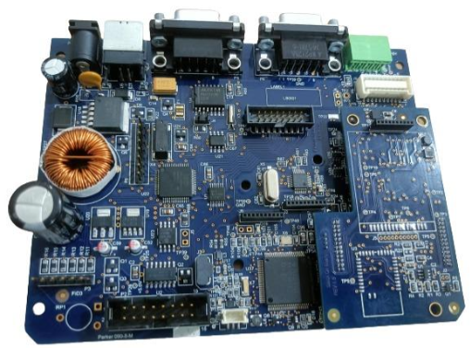
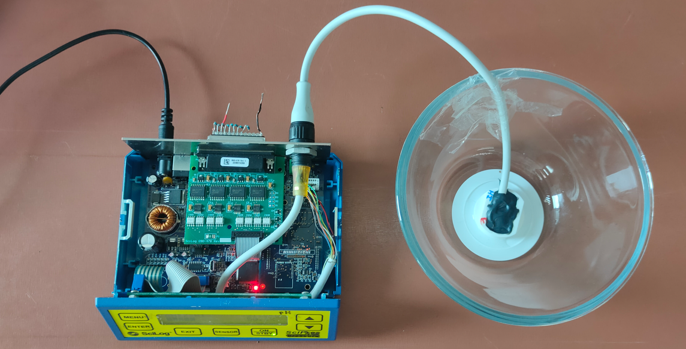
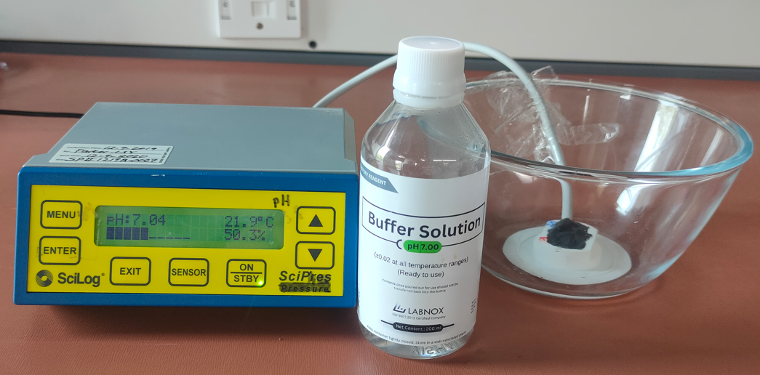
Division: Bioscience
SCIpH
Scope
Initial scope of the project was to integrate SPI to USB converter in SCI Monitor and develop firmware for same to upgrade the system with USB interface and build 10-prototypes with MAX3421 evaluation boards.
Design of hardware with common PCB by integrating all the sub modules i.e., header board, daughter board, LCD board, SCI Monitor and build 20-protyotypes. Test with existing firmware with few of the new features developed in firmware.
Challenges
Some of the functional testing at client location because of dependency on the end customer application setup
Environment
Altium for schematics and PCB layout designing
IAR Workbench
32-bit PIC Microcontroller
J-Link Debugger
Benefits and Improvements
Solution
Hardware, firmware completely owned by POEC.
10 Proto units (for initial testing)
New board with on-board Senova PDK functionality - 20 proto units

